Slide 1
ANUDIP FOUNDATION
^{Karthik Reddy}
^{Chinna Rathod}
^{Sandeep}
^{Raja}
^{Hiranya}
^{Nithish vasala}
^{Muqeet khan}

Slide 2
Expense Details for 6 Months

Slide 3
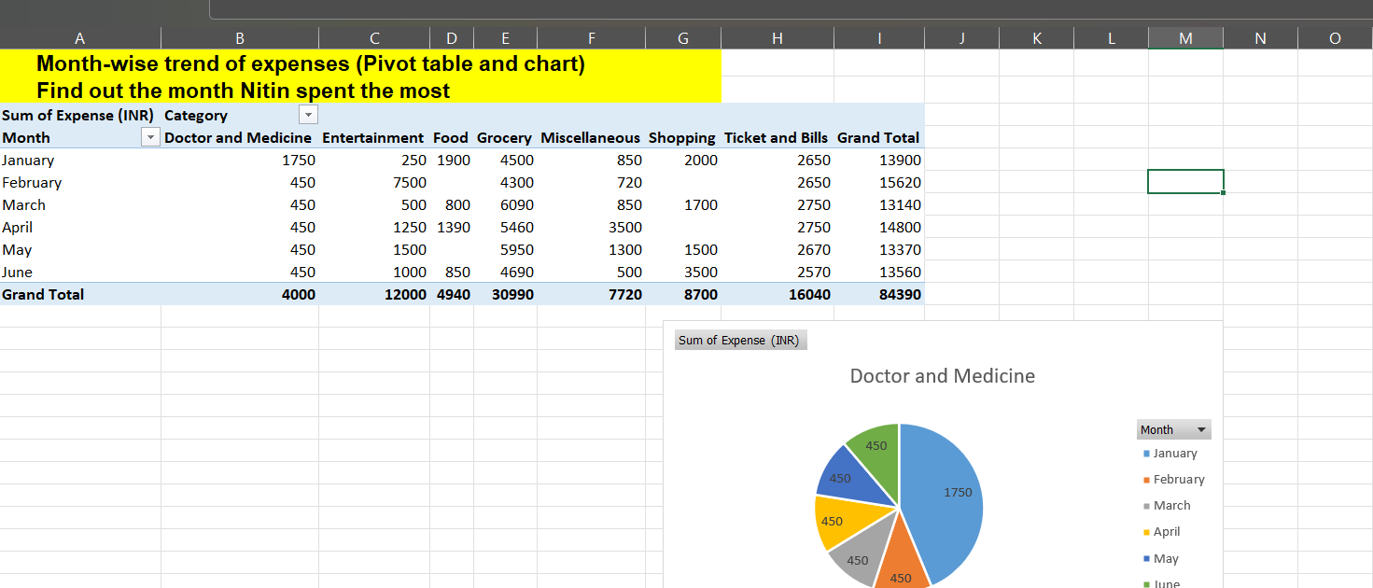

Slide 4
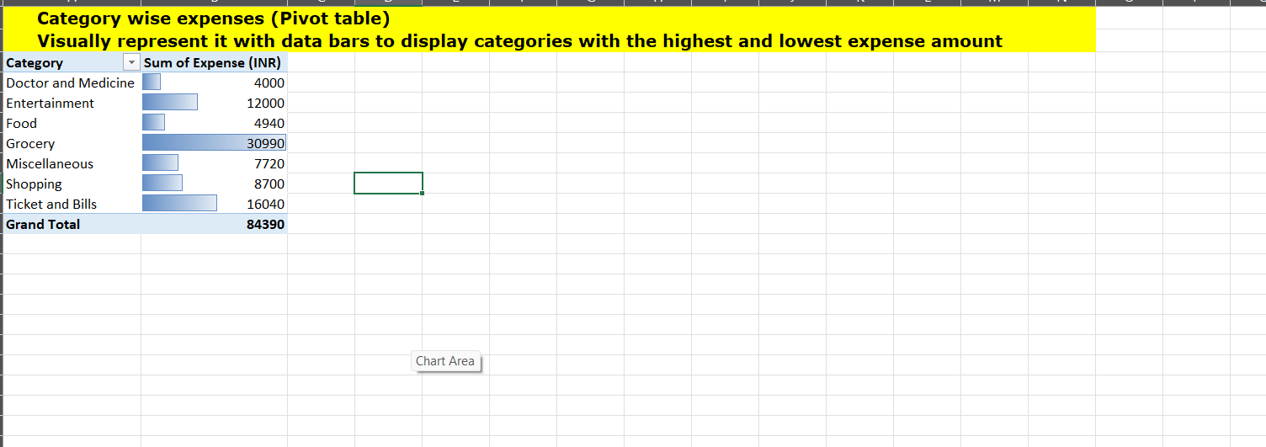

Slide 5
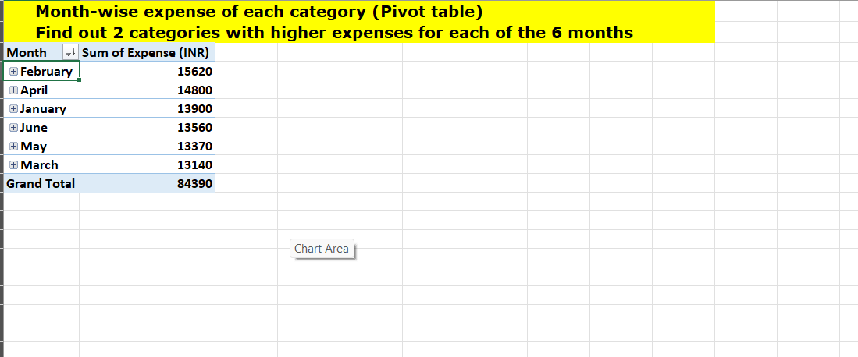

Slide 6
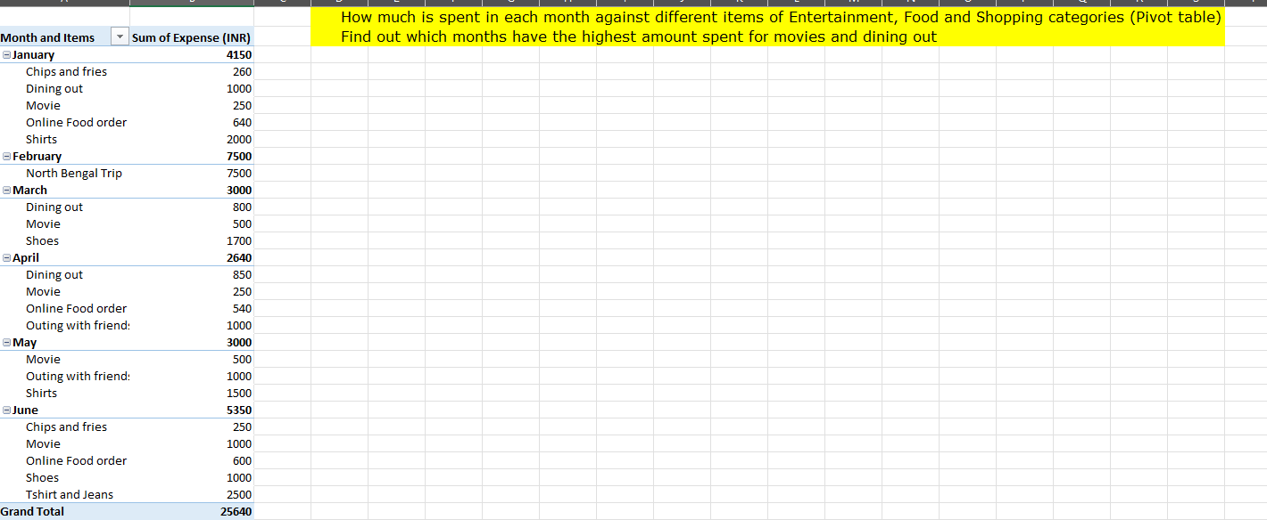

Slide 7
Essential Items
These are necessary for basic living needs and well-being for nithin decisions about his spending and increase his savings,
Food:
Groceries (Foodgrains, Vegetables, Fruits, etc.)
Dining Out (if occasional and necessary)
Online Food Order (if essential)
Doctor and Medicine:
Medical expenses for essential health care
Ticket and Bills:
Gas
Electricity Bill
Railway Monthly Ticket
House Help (if necessary)

Slide 8
Less Essential Items
These are discretionary or non-urgent expenses that can be reduced or avoided.
Entertainment:
Movies
Outing with Friends
Shopping:
Shirts
Shoes
T shirts and Jeans
Miscellaneous:
Unplanned expenses like gifts (unless necessary)

Slide 9
Recommendations to Increase Savings
Review and Adjust Spending:
Prioritize Essentials: Focus on reducing spending in less essential categories. For instance, limit the frequency of dining out and reduce discretionary shopping.
Create a Budget:
Set Limits: Establish monthly spending limits for both essential and less essential categories.
Save on Utilities and Bills:
Reduce Consumption: Be mindful of electricity and gas usage to lower bills
Cut Unnecessary Shopping:
Set Savings Goals:
Automate Savings: Set up automatic transfers to a savings account as soon as income is received.

Slide 10
EXPENSE DETAILS FOR THE MONTH OF JUNE

Slide 11
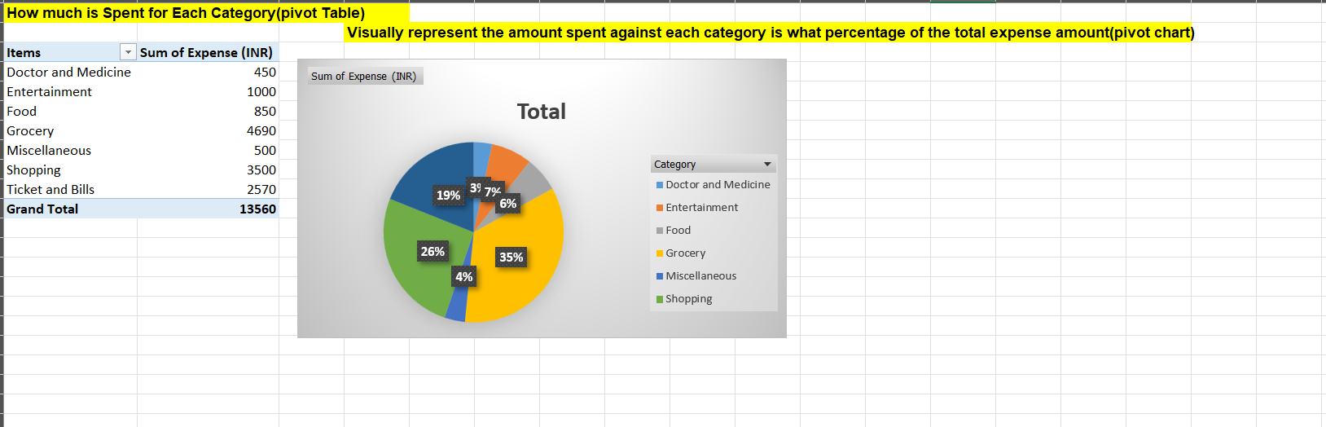

Slide 12
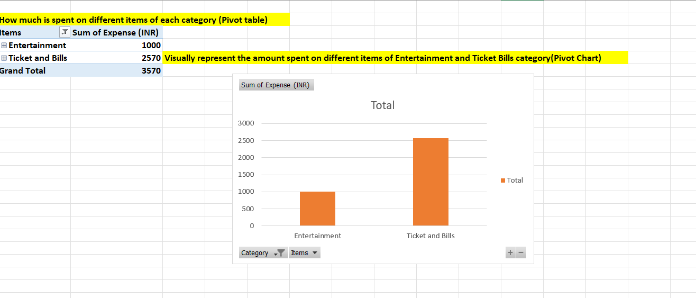

Slide 13
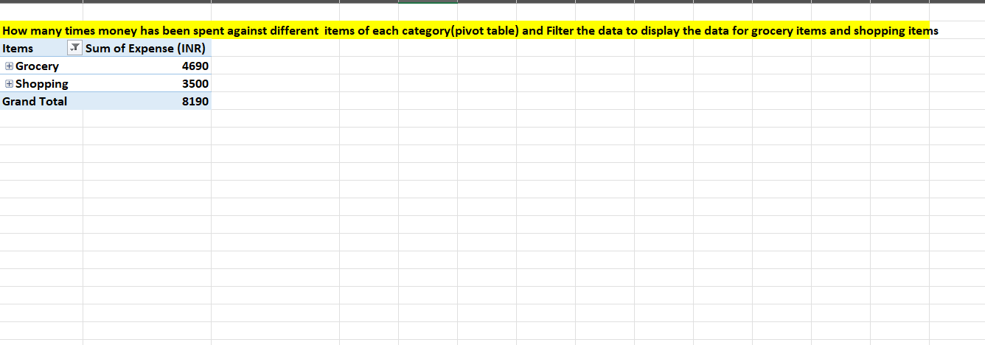

Slide 14
